Slide 1
E-shopping application
Presentation can be done in many ways but few methods are the:
1.Log in module
2.Searching module
3.Purchase module
4.Payment module
5.Delivery and logistic module
6.Adding products to the portal to implement

Slide 2


Slide 3
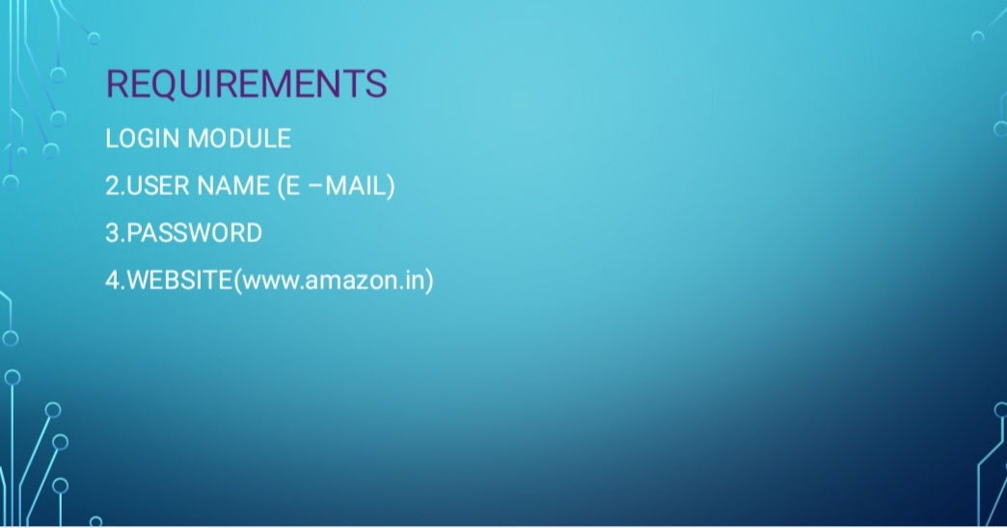

Slide 4
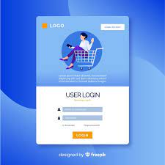
1.Log In module for the e-shopping application

Slide 5
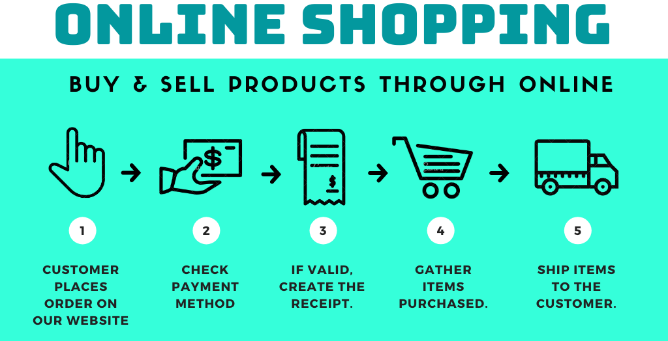
Searching module:

Slide 6
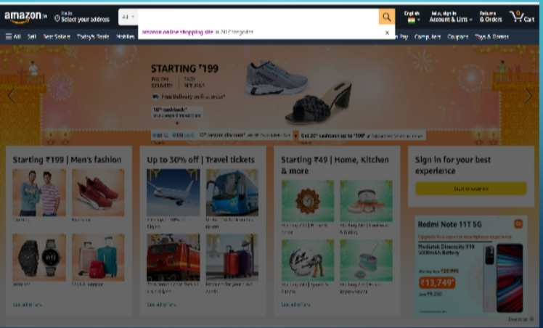
search module:

Slide 7
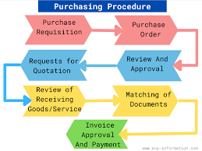
Purchase module:

Slide 8
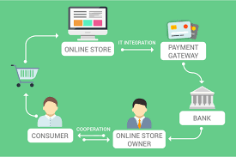
Payment module:

Slide 9
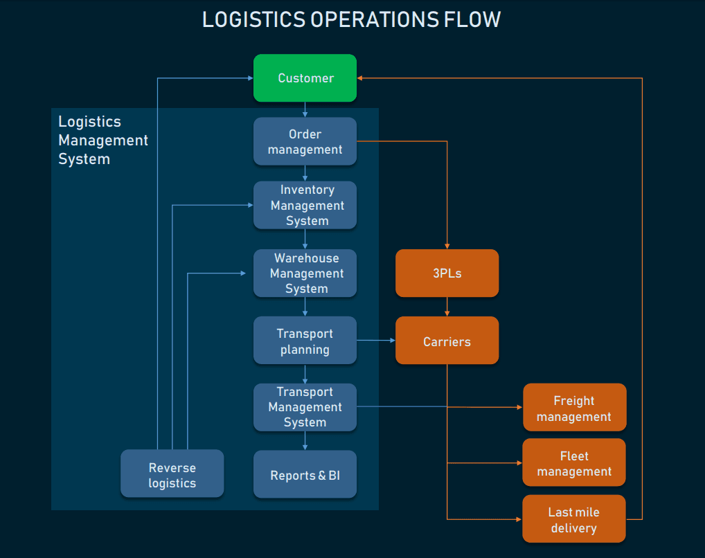
Delivery and logistic module:

Slide 10
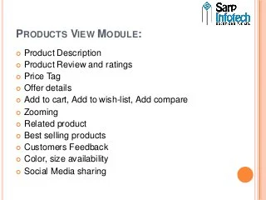
Adding products

Slide 11
E-Online shoping applications :
Online shopping is a form of electronic commerce which allows consumers to directly buy goods or services from a seller over the Internet using a web browser or a mobile app. Consumers find a product of interest by visiting the website of the retailer directly or by searching among alternative vendors using a shopping search engine, which displays the same product's availability and pricing at different e-retailers. As of 2020, customers can shop online using a range of different computers and devices, including desktop computers, laptops, tablet computers and smartphones.
An online shop evokes the physical analogy of buying products or services at a regular "bricks-and-mortar" retailer or shopping center; the process is called business-to-consumer (B2C) online shopping. When an online store is set up to enable businesses to buy from another businesses, the process is called business-to-business (B2B) online shopping. A typical online store enables the customer to browse the firm's range of products and services, view photos or images of the products, along with information about the product specifications, features and prices.

Slide 12
Test cases for E-shopping applications : :
Verify that the user is able to navigate through all the products across different categories.
Verify that all the links and banners are redirecting to correct product/category pages and none of the links are broken.
Verify that the company logo is clearly visible.
Verify that all the text – product, category name, price, and product description are clearly visible.
Verify that all the images – product and banner are clearly visible.
Verify that category pages have a relevant product listed specific to the category.
Verify that the correct count of total products is listed on the category pages.
Search – Verify that on searching all the product satisfying the search criteria are visible on the search result page.
Search – Verify the more relevant product for the search term is displayed on the top for a particular search term.
Search – Verify that count of products is correctly displayed on the search result page for a particular search term.

Slide 13
Test cases for E-shopping application:
Verify that on the product page, the user can select the desired attribute of the product e.g. size, color, etc.
Verify that the user can add to cart one or more products.
Verify that users can add products to the wishlist.
Verify that the user can buy products added to the cart after signing in to the application (or as per the functionality of the website).
Verify that the user can successfully buy more than one product that was added to his/her cart.
Verify that the user cannot add more than the available inventory of the product.
Verify that the limit to the number of products a user can by is working correctly by displaying an error message and preventing the user from buying more than the limit.
Verify that the delivery can be declined for the places where shipping is not available.
It explains the E –shopping application .

Slide 14
Positive test scenario for E-shopping application:
Verify that the shopping cart icon is displayed as expected or not.
Verify that the shopping cart icon is clickable or not
Verify that the user is able to add items into the cart or not
Verify if the user increases the number of items then the cart should be reflected as per quantities
Verify if the user decreases the number of items then the cart should be reflected as per quantities
Verify that the user is able to click on the cart icon button when the cart is empty
Verify that when the user clicks on the cart button then the user should navigate to the shopping cart page
Verify that the user is able to remove items from the cart
Verify that each items’ price on the shopping cart page

Slide 15
The negative test scenario for E-shoping application:
Verify that the user is able to proceed with a negative number like (-1,-2,-3….)
Verify if the cart is editable then check that the user is able to enter floating numbers
Verify if the cart is editable then check that the user is able to enter special characters
Verify that the user is able to proceed with an empty cart or not
Verify that each items’ price on the shopping cart page
Verify that all item’s total prices on the shopping cart page

Slide 16
The conclusion:
Technology has made significant progress over the years to provide consumers a better online shopping experience and will continue to do so for years to come. With the rapid growth of products and brands, people have speculated that online shopping will overtake in-store shopping.
E-Commerce is not an IT issue but a whole business undertaking. Companies that use it as a reason for completely re-designing their business processes are likely to reap the greatest benefits. Moreover, E-Commerce is a helpful technology that gives the consumer access to business and companies all over the world.
rtar store. At the end, it has been a win-win situation for both consumer and sellers of it.

Slide 17
THANK YOU

